Slide 1
INTRODUCTION TO DESIGN PATTERNS – A Running Example
Dr. Jicheng Fu

Slide 2
RPN – Reverse Polish Calculator
HP first used this concept to develop a RPN calculator
Example
(4 + 5) × 6 could be expressed as
4 5 + 6 ×
Used a stack

Slide 3
Example
Initial Stack |  |  |  | After 5 |  |  | After ENTER
 | T | 4 |  | T | 3 |  | T | 2
 | Z | 3 |  | Z | 2 |  | Z | 1
 | Y | 2 |  | Y | 1 |  | Y | 5
 | X | 1 |  | X | 5 |  | X | 5
Press: |  | 5 |  |  | ENTER

Slide 4
Example (cont.)
Now to add 8 to the 5 already entered, see the example below:
When the 8 was pressed, it overwrote the 5 in the stack
Stack from above |  |  |  | After 8 |  |  | After +
 | T | 2 |  | T | 2 |  | T | 3
 | Z | 1 |  | Z | 1 |  | Z | 2
 | Y | 5 |  | Y | 5 |  | Y | 1
 | X | 5 |  | X | 8 |  | X | 13
Press: |  | 8 |  |  | +

Slide 5
Initial Design
Issues?
Too many conditional checking in the code?
Solution?
Build our own stack
Make necessary checks inside the stack

Slide 6
Improvement
Issues
Number of operators may go infinitely
The action list in RpnCalculator class may become very long

Slide 7
Strategy Pattern

Slide 8
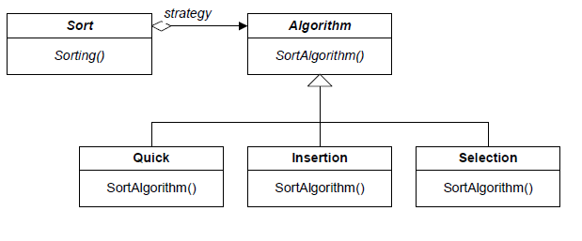
Strategy Pattern – Another Example
Sorting algorithms

Slide 9
Strategy Pattern
Intent
defines a family of algorithms/operations, encapsulate each one, and make them interchangeable. Strategy lets the algorithm vary independently from clients that use it.
Motivation
when there are many algorithms/operations for solving a problem, hard-wiring all algorithms in client’s code may have several problems
Clients get fat and harder to maintain
Different algorithms may be appropriate at different time
It is difficult to add new algorithms

Slide 10
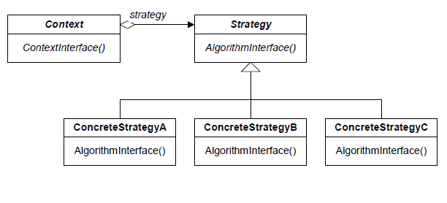
Strategy Pattern – General From

Slide 11
Participants of Strategy
Strategy: declares an interface common to all supported algorithm. Context uses this interface to call the algorithm defined by a Concrete Strategy.
ConcreteStrategy: implements the algorithm using the Strategy interface
Context: maintains a reference to a Strategy object and defines an interface that let Strategy access its data

Slide 12
Improvement
How to control operator creation?

Slide 13
Factory Pattern

Slide 14
Factory Pattern
Intent
Provides an interface for creating families of related or dependent objects without specifying their concrete classes
Motivation
Sometimes we have systems that support different representations depending on external factors.
The factory provides an interface for the client. In this way the client can obtain a specific object through this abstract interface.

Slide 15
Improvement
Can we do better?
What about complex operations with several atomic or composite operations?
E.g., a special operation with + first and then *
Solution
Composite Pattern

Slide 16
Composite Pattern

Slide 17
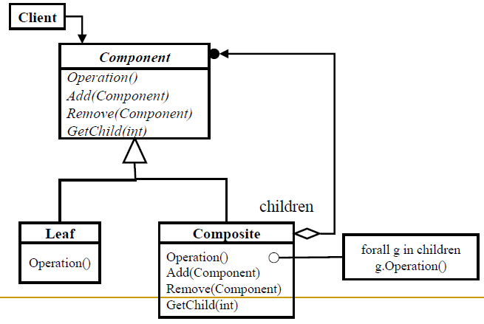
Composite Pattern – General Form

Slide 18
Composite Pattern
Intent
Compose objects into tree structures to represent part-whole hierarchies. Composite lets clients treat individual objects and compositions of objects uniformly.
Motivation
If the composite pattern is not used, client code must treat primitive and container classes differently, making the application more complex than is necessary.

Slide 19
Participants of Composite
Component
Declares the interface for objects in the composition.
Implements default behavior for the interface common to all classes.
Declares an interface for accessing and managing its child components.
Defines an interface for accessing a component’s parent in the recursive structure (optional).

Slide 20
Participants of Composite
Composite
Defines behavior for components having children.
Stores child components.
Implements child-related operations in the component interface.

Slide 21
Benefits of Design Patterns
Design patterns enable large-scale reuse of software architecture
They also help document systems to enhance understanding
Patterns explicitly capture expert knowledge and design tradeoffs, and make this expertise more widely available
Patterns help improve developer communication
Pattern names forms a vocabulary
Patterns help ease the transition to object-oriented technology

Slide 22
Drawbacks to Patterns
Patterns do not lead to direct code reuse
Patterns are deceptively simple
Teams may suffer from pattern overload
Patterns are validated by experience and discussion rather than by automated testing
Integrating patterns into a software development process is a human-intensive activity

